Slide 1
MAR 530: Ecosystem Based Fisheries Management
Lecture 7
Extended single-species and multispecies models
www.mycourses.umassd.edu
13 March 2015

Slide 2
Today’s Outline
Fisheries models
Extended single-species models
Multispecies models
Discussion on:
Hollowed et al. 2000
Keyl & Wolff 2008
Whipple et al. 2000

Slide 3
One Main Theme Throughout Course
CONFRONTING TRADEOFFS

Slide 4
Simplified Schedule
Week | Theme | Topic
1/30 | Context | Introduction, What is EBFM?
2/6 |  | Challenges facing fisheries, what can EBFM offer?
2/13 |  | Guest lecture: case studies of EBFM
2/20 |  | Types of advice, decision theories, goal-setting
2/27 | Operational | Bycatch, habitat, and spatial management
3/6 |  | Ecosystem indicators
3/13 |  | Extended single-species and multispecies models
3/20 |  | SPRING BREAK
3/27 |  | Aggregate and system models
4/3 |  | Ecological risk assessment
4/10 | Institutional | Societal and economic considerations
4/17 |  | Governance and management institutions
4/24 | Holistic | Evaluating tradeoffs
5/1 |  | Moving towards ecosystem based management
5/8 |  | Final exam: Project Presentations

Slide 5


Slide 6
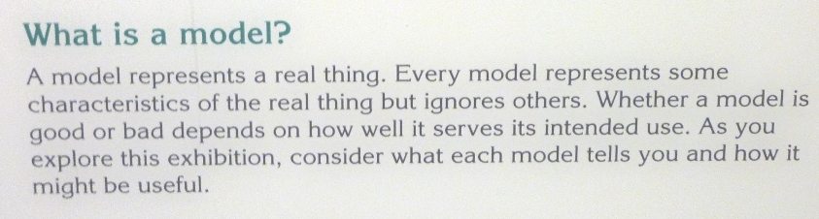
What is a Model?
A simplified abstraction of a more complicated object.
Conceptual model: set of assumptions in natural language that describe a system.
Mathematical model: set of assumptions represented mathematically that describe a system.
The assumptions underlying a model can be considered as alternative hypotheses.
Why use mathematical models?

Slide 7
Use of models in fisheries and conservation
How many are there?
Estimating extinction risk.
How many can we harvest?
System relationships and dynamics
How well are hypotheses supported by data?
Designing management programs

Slide 8
All you ever need to know for Population Modeling
Numbers next year = numbers this year
+ births – deaths + immigrants – emigrants

Slide 9
Simple, yet comprehensive.
Major processes are implied, but not often explicitly parameterized.
Any number of terms can be added to incorporate the appropriate level of explicitness for each process.
N can be a species, a stock, a guild, an aggregate, etc.

Slide 10
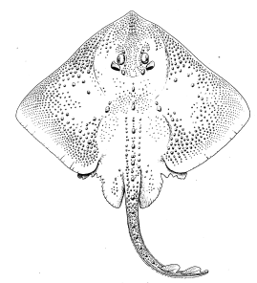
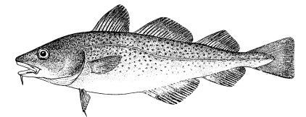
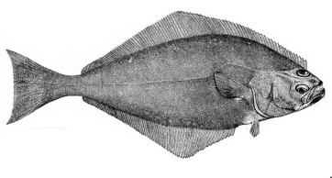
Gradient of possible tools
Stock/Single Species
Multi-species
Aggregate Biomass
Ecosystem
Messy Picture Here
Gadids
Pelagics
Flatfish
Single species models, forget ecosystem issues
food web models
Multi-species assessments
Extended single species models with predation mortality, habitat or climate effects
Whole system models, forget population dynamics
Aggregate Biomass Models
Multiple single species assessments in “harmony”

Slide 11
Major ecological models used in fisheries
Single species
Single species with add-ons
Multi-species
Biophysical
Food web
Aggregate biomass
Biogeochemical
Full system
Non-ecological models are also used.
e.g. many data-poor stock assessments.

Slide 12
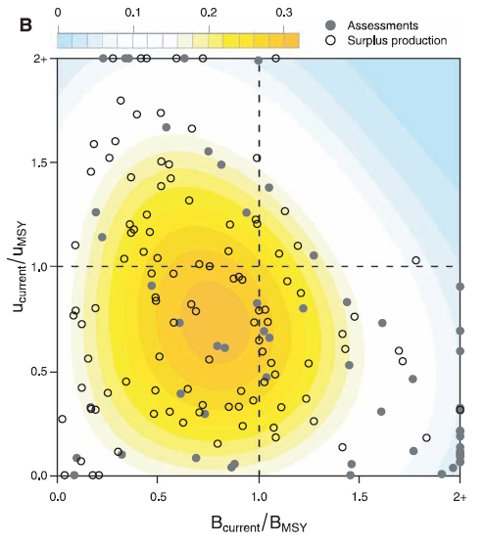
Single Species Models in Fisheries
Intended Purpose:
Assess the status of fishery stocks
Pros:
Classical approach in fisheries
Well established models & approaches
Cons:
“Precision v. Accuracy” issue: may miss other influences on stocks
Data Needs:
Standard (i.e. landings, bycatch, survey abundance/biomass; maybe size/age structure)
Worm et al. (2009) Rebuilding global fisheries. Science 325:578-585.

Slide 13
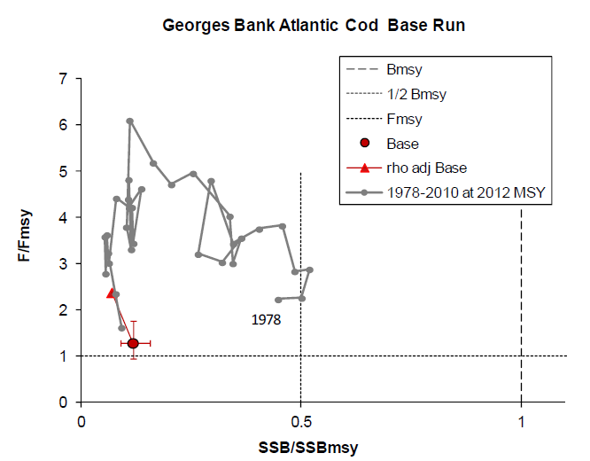
Single Species Models in Fisheries
Intended Purpose:
Assess the status of fishery stocks
Pros:
Classical approach in fisheries
Well established models & approaches
Cons:
“Precision v. Accuracy” issue: may miss other influences on stocks
Data Needs:
Standard (i.e. landings, bycatch, survey abundance/biomass; maybe size/age structure)
NEFSC (2013) 55th Northeast Regional Stock Assessment Workshop (55th SAW) Assessment
Summary Report. US Dept Commer, Northeast Fish Sci Cent Ref Doc. 13-01; 41 p.

Slide 14
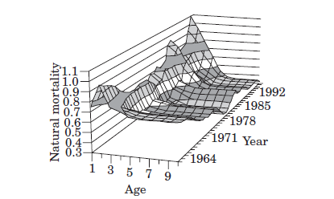
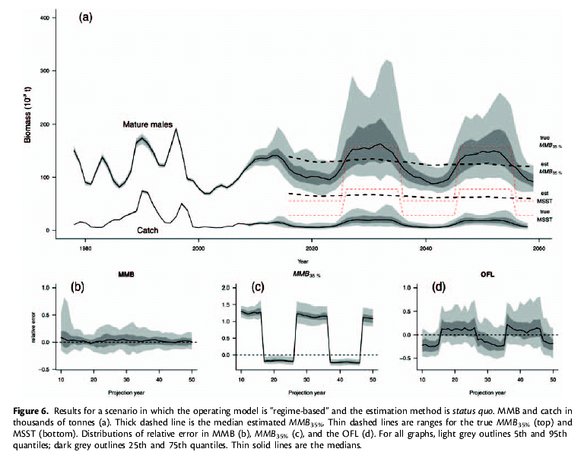
Extended single-species models in fisheries
Intended Purpose:
Assess the status of fish stocks with additional factors added in.
Also known as:
Minimal Realistic Models
Models of Intermediate Complexity
Pros:
Enhanced biological/ecological/ environmental realism
Same model outputs as standard fisheries models
Cons:
Extra data requirements
Harder to insert into management process
Data Needs:
Standard plus stomach or environmental.
Hollowed et al. 2000. ICES J. Mar. Sci. 57: 279–293.
Szuwalski & Punt 2012. ICES J. Mar. Sci. doi:10.1093/icesjms/fss182.

Slide 15
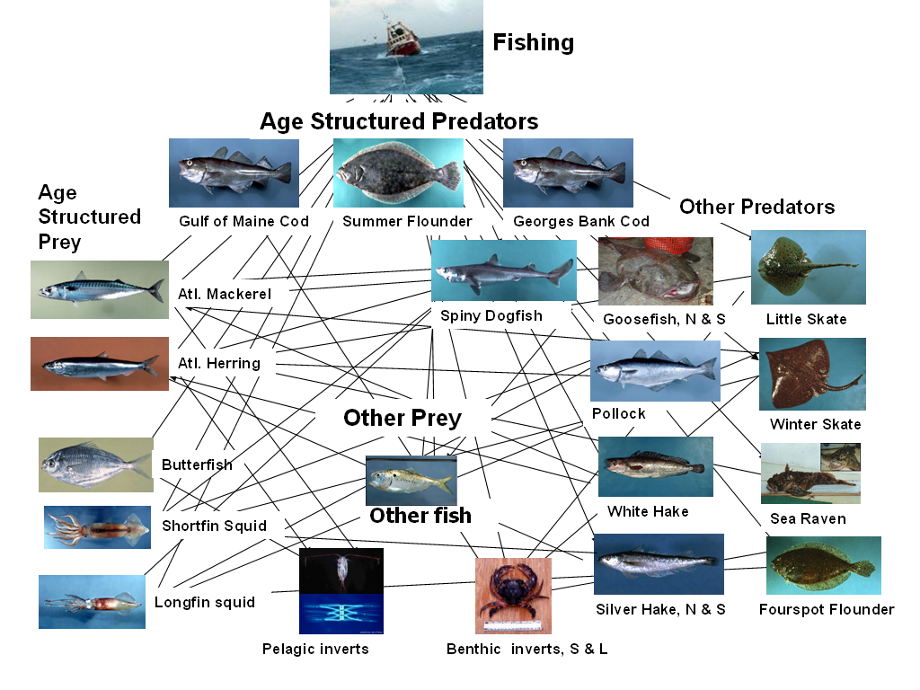
Multi-species models in fisheries
Intended Purpose:
Assess the status of stocks simultaneously, usually with some form of interactions among species, gear, etc.
Pros:
Improvement over MRMs as additional factors are modeled concurrently
Model outputs are still in familiar form
Cons:
Functional form of several interactions debated
Even more data requirements
May still miss other key factors
Data Needs:
Standard plus stomach

Slide 16
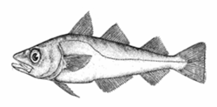
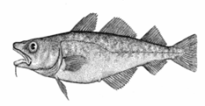
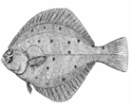
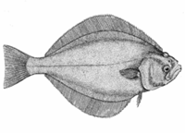
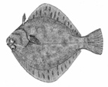
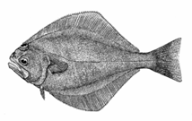
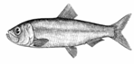
What difference does it make? Tactically: Biological Reference Points
From Aydin et al

Slide 17
What difference does it make? Strategically: Tradeoffs
Mammals
Option 1-
Balance
Option 2-
GB Now
Elasmobranchs
Groundfish
Pelagics
Decapods & Molluscs
Junk Fish
Option 3-
Whale Hugger
Option 4-
GB 1950s
Option 5-
Rape & Pillage

Slide 18
Single Species Models
Index-based methods
Equilibrium & Generation methods
Yield-Per-Recruit / Stock-Recruitment
Population dynamics models
Biomass aggregated models
e.g. production models
Stage-Structured models
Age structured models, size-based models, virtual population analysis, statistical catch-at-age

Slide 19
Single Species Models
Index-based methods
Equilibrium & Generation methods
Yield-Per-Recruit / Stock-Recruitment
Population dynamics models
Biomass aggregated models
e.g. production models
Stage-Structured models
Age structured models, size-based models, virtual population analysis, statistical catch-at-age

Slide 20
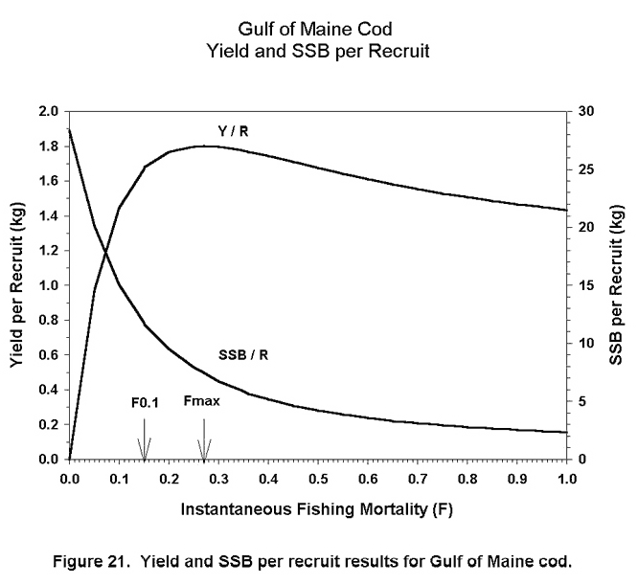
Yield per Recruit
Balance mortality with growth
Implications of fishing intensities/selectivities.
Constant recruitment
Mayo, R.K.; Thunberg, E.M.; Wigley, S.E; Cadrin, S.X. 2002. The 2001 assessment of the Gulf of Maine Atlantic cod stock. Northeast Fish. Sci. Cent. Ref. Doc. 02-02; 154 p.

Slide 21
Spawning Biomass per Recruit
At a given F, there is a constant SPR
Linear relationship between R and resulting SSB (S=xR).
Recruits
e^{-(F+M)}
Adults
reproduction
Adapted from Cadrin

Slide 22
Spawner-Recruit Relationships
Used to predict recruitment as a function of mature stock size.
Density dependence in Recruits per Spawner
Beverton-Holt:
Ricker:

Slide 23
Single Species Models
Index-based methods
Equilibrium & Generation methods
Yield-Per-Recruit / Stock-Recruitment
Population dynamics models
Biomass aggregated models
e.g. production models
Stage-Structured models
Age structured models, size-based models, virtual population analysis, statistical catch-at-age

Slide 24
Biomass dynamic (Surplus production) models
Surplus production models are commonly defined by equations such as:
where B_{t} is the biomass at the start of year t, f(B_{t}) is the biomass-dynamic as a function of biomass and C_{t} is the catch in weight during year t.
Typical model formulations: Pella Tomlinson, Gompertz-Fox, Graham-Schaefer.
In the absence of fishing, rate of population change is assumed to be a function of the current population size only:
where r = intrinsic rate of population growth, and K = carrying capacity.

Slide 25
Graham-Schaefer production model (logistic growth)
Numbers next year are number this year + net production, minus removals
Catch in
time t
Net production
Population size
time t+1
Carrying capacity
Intrinsic (maximum)
rate of increase
Adapted from Branch

Slide 26
Single Species Models
Index-based methods
Equilibrium & Generation methods
Yield-Per-Recruit / Stock-Recruitment
Population dynamics models
Biomass aggregated models
e.g. production models
Stage-Structured models
Age structured models, size-based models, virtual population analysis, statistical catch-at-age

Slide 27
Age-Structured Models
Age-structured models are constructed by selecting specific hypotheses for each key population dynamic process:
Growth, fecundity, natural mortality, exploitation, recruitment
Processes can be time-invariant, stochastic, density-dependent or depensatory.
Typical outputs include:
Abundance of various age-classes
Trends in spawning/vulnerable biomass
Trends in fishing mortality
There are many flavors, typically differentiated by backward (e.g. VPA) or forward (e.g. SCAA) estimation methods.

Slide 28
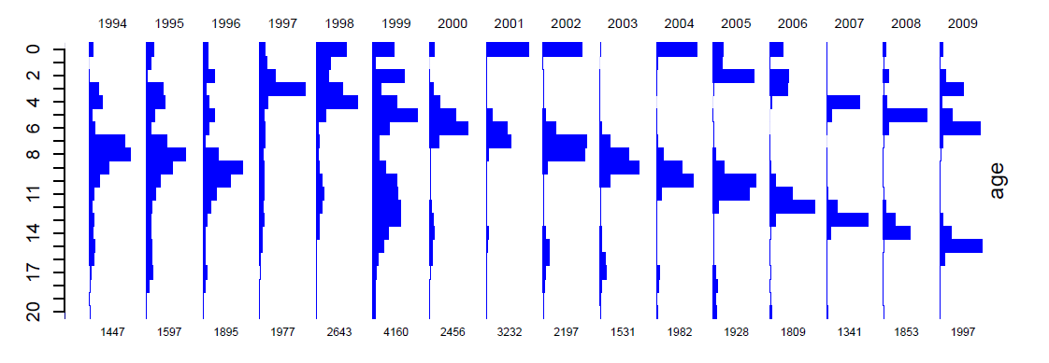
Aim is to use data on the catch-at-age to reconstruct year class size, to give a total population estimate.
Standard VPA works ‘backwards’ over the lifespan of a year-class.
whereas SCAA works ‘forwards’.
Adapted from Cadrin
Klaer et al. 2011. CSIRO.

Slide 29
Age-structured models
Advantages:
Populations have age-structure!
More realistic - many processes (birth rate, death rate, growth) are age-specific.
Easily to build in actual processes and highly flexible.
Disadvantages:
Increased complexity.
Data required are not always available.
Age-lumped models often perform as well as age-structured models.
Still not that realistic (no predation, competition, size and spatial structure).

Slide 30
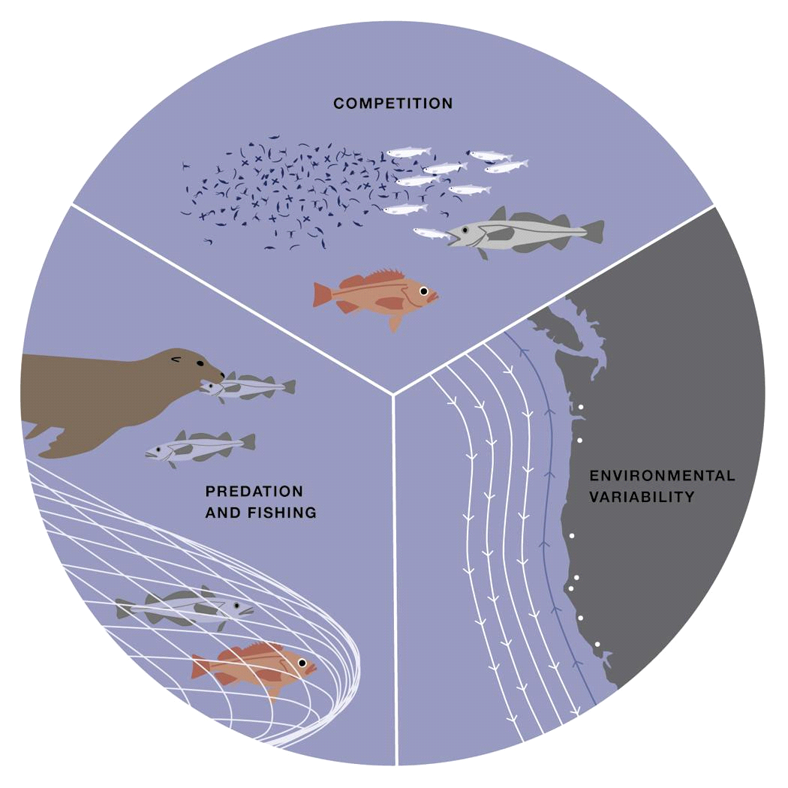
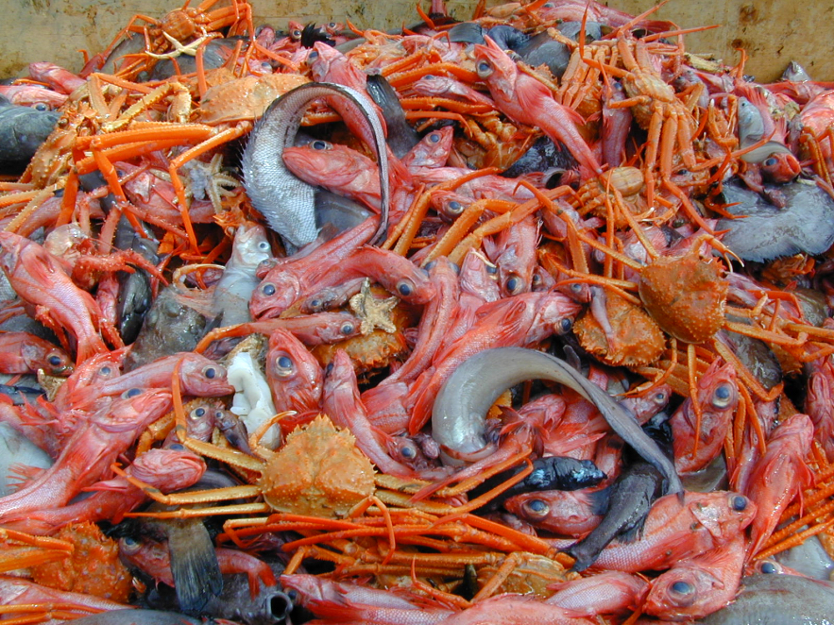
Moving these models towards EBFM
These models do not so far (explicitly) consider ecosystem processes.
However, all can be modified (in multiple ways).
© Amity Femia

Slide 31
Extended Single Species Models
Equilibrium & Generation methods
Yield-Per-Recruit / Stock-Recruitment
Population dynamics models
Biomass aggregated models
e.g. production models
Stage-Structured models
Age structured models, size-based models virtual population analysis, statistical catch-at-age
Not amenable for index-based assessments (?)

Slide 32
Extended Single Species Models
All of the models discussed can be expanded to include ecosystem considerations.
Adding in predation
S-R Z = F + M
Prod M = M1 + M2
VPA
Predation treated as another “fleet”

Slide 33
Extended Single Species Models
Adding in Environment
Stock-Recruitment relationship
Productivity
Model covariates on life history parameters

Slide 34
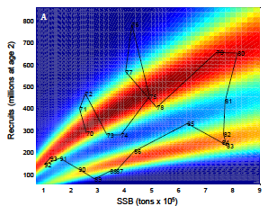
Extended Single Species Models
Growing number of examples of single species add-ons.
Many ways in which to implement these models.
An excellent, active area of research.
Munch et al. Environmental regimes and density-dependence: a Bayesian modeling approach for identifying recruitment regimes.

Slide 35
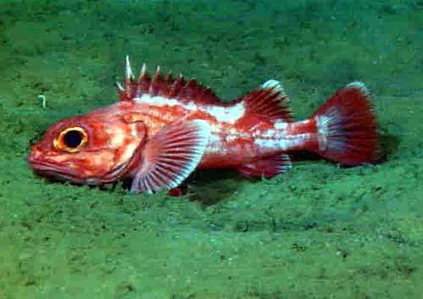
Adding Predation Longspine thornyhead, U.S. West Coast
Survey biomass estimates for longspine show increasing trend
Assessment model with fixed M unable to capture increasing trend.
Sablefish and Shortspine prey heavily on Longspine
Biomass of both predators has declined substantially.
Including biomass of sablefish as a factor controlling the value of M improved model fit.
Fay & Field (2006) Pacific Fishery Management Council)

Slide 36
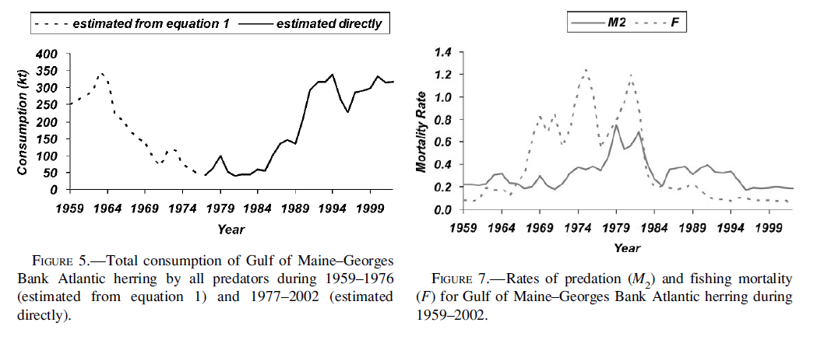
Gulf of Maine-Georges Bank Atlantic herring
W. J. Overholtz , L. D. Jacobson & J. S. Link (2008): An Ecosystem Approach for Assessment Advice and Biological Reference Points for the Gulf of Maine–Georges Bank Atlantic Herring Complex, North American Journal of Fisheries Management, 28:1, 247-257
Overholtz & Link (2007) Consumption impacts by marine mammals, fish, and seabirds on the Gulf of Maine–Georges Bank Atlantic herring (Clupea harengus) complex during the years 1977–2002. ICES Journal of Marine Science, 64: 83–96.

Slide 37
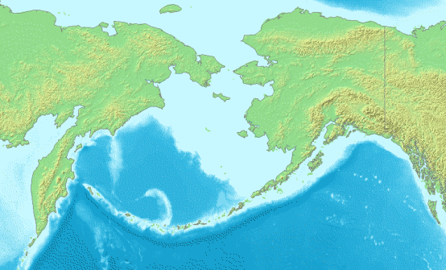

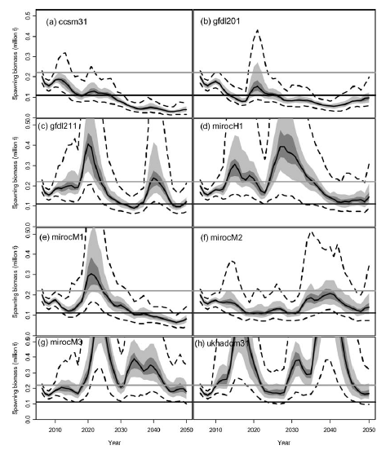
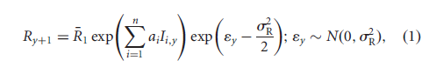
Climate effect on Recruitment Bering Sea Walleye pollock
Recruitment modeled as a function of a climate index.
Stock assessment model projections under different IPCC scenarios and fishing strategies.
Status quo management very sensitive to the IPCC model used.
A’mar, Z. T., Punt, A. E., and Dorn, M. W. 2009. The evaluation of two management strategies for the Gulf of Alaska walleye pollock fishery under climate change. – ICES Journal of Marine Science, 66: 1614–1632.

Slide 38
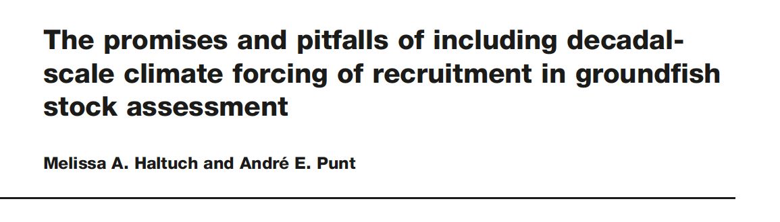
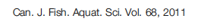
Challenges in implementing extended single-species approaches
Result-driven or data-driven?
Difficulty in defining relationships with covariates.
Gain in performance sometimes uncertain.
What to do about Reference points?
e.g. 2012 Gulf of Maine Cod assessment
2 models, one with time-varying natural mortality
Results in (at least) four options for setting quota:
M_{0.2} model with M=0.2 for projections: standard procedures
M_{Ramp} model with M=0.2 for projections: standard procedures
M_{Ramp} model with M=0.4 for some period then reverting to M=0.2
M_{Ramp} model with M=0.4 in perpetuity (regime shift scenario)

Slide 39
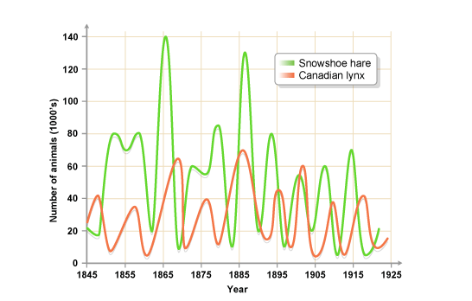
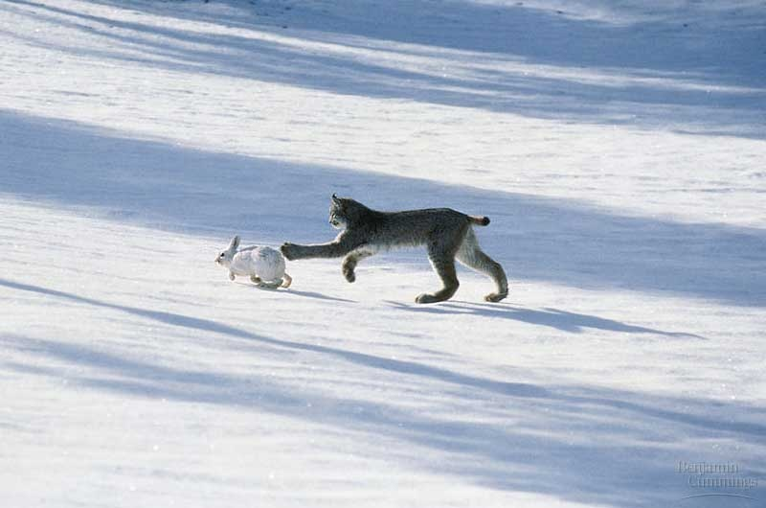
Multispecies models
Effectively a set of single species models with some form of linkage between them, usually species interactions, all modeled simultaneously.
Image from: http://www.anselm.edu/homepage/jpitocch/genbios/52-19a-PopCycleHareLynxPhot.jpg
Image from bbc.co.uk

Slide 40
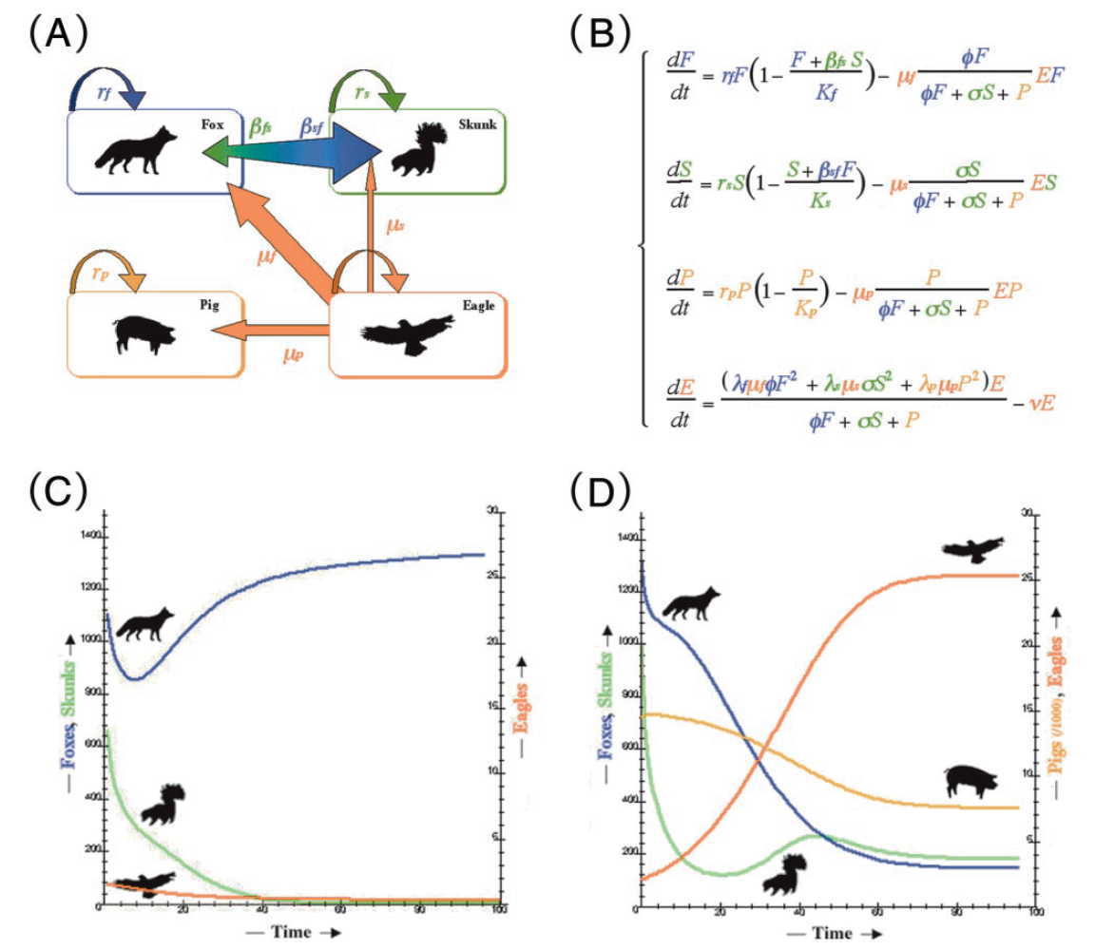
A simple multispecies model
Multispecies equations
Channel Islands: introduced feral pigs allowed golden eagles to establish and increase, greatly increasing predation (hyperpredation) on native foxes. Low fox numbers allowed competitively inferior skunks to flourish.
No pigs
Pigs
From Branch
Roemer, G.W., Donlan, C.J., and Courchamp, F. 2002. Golden eagles, feral pigs, and insular carnivores: How exotic species turn native predators into prey. Proc. Natl Acad. Sci. U.S.A. 99(2): 791-796.

Slide 41
Multispecies Models
Multispecies Yield-per-recruit (MSYPR)
These add technical interactions to YPR models.
Similar to YPR models, but effectively focus on bycatch, mixed species fisheries.

Slide 42
Multispecies Models
Multispecies Production Models
Non age-structured
Usually species interactions
e.g. add in terms for competition and predation to production model:
Gamble, R.J. and J.S. Link. 2009. Analyzing the tradeoffs among ecological and fishing effects on an example fish community: A multispecies (fisheries) production model. Ecol. Mod. 220: 2570-2582.

Slide 43
Multispecies Models
Multispecies Virtual Population Analysis (MSVPA)
Age structured assessments, linked with a predator-prey model

Slide 44
Structure of MSVPA Model
Suitability
Parameters
Diet Data
Consumption = Predator BM * %DR
Other Food
P_{prey} = (Suitable Biomass)_{prey} / Total Suitable Biomass
M2_{age}
C_{prey} = Consumption * P_{prey}
M2_{prey} = C_{prey} / BM_{prey}
BM_{age}
BM_{age}
BM_{age}
BM_{age}
BM_{age}
Other
Predators
Single Species VPA
Adapted from Garrison et al.

Slide 45
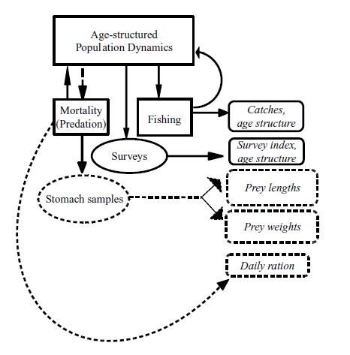
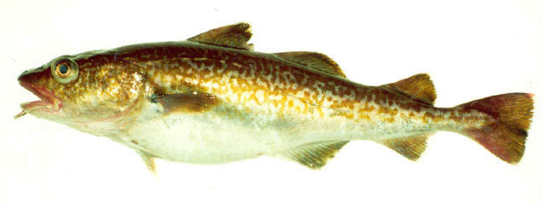
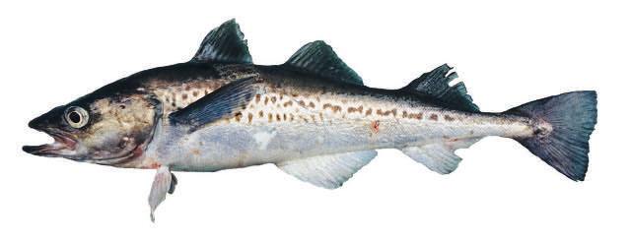
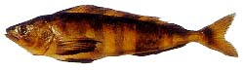
Multispecies statistical catch-at-age models
Simultaneous stock assessments of multiple species fitted to numerous data, including diet information.
e.g. Aleutian Islands groundfish fishery.
Walleye pollock, Atka mackerel, and Pacific cod interact as predators and prey.

Slide 46
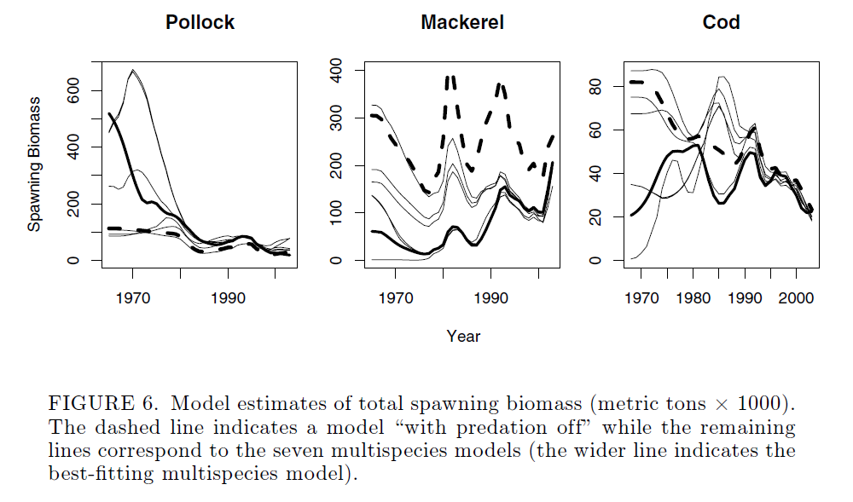
Multispecies statistical catch-at-age models
Again, outputs can differ substantially from single-species models.
Models sensitive to form of functional response.
Kinzey & Punt (2009) Multispecies and single-species models of fish population dynamics: comparing parameter estimates. Natural resource modeling 22: 67-104.

Slide 47

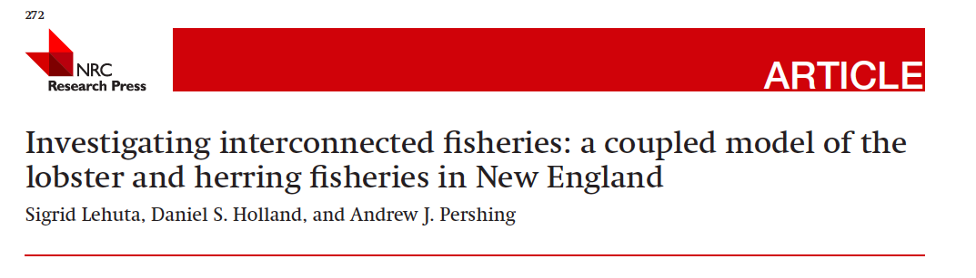
Multispecies Models
Bioeconomic Models
Variable math (production, age structured)
Explore tradeoffs among species interactions and value of different stocks simultaneously.

Slide 48
Minimal Realistic Models
Objective of these models is to consider the interactions among a small number of species, and components
e.g.
Developing a multi-species model with a small number of predators.
Focusing on ‘key’ system properties/components relevant to the research or management questions.

Slide 49
Barents Sea Minke Whales-Cod-Capelin EXAMPLE
Several models:
GADGET,
BORMICON,
MULTSPEC, etc.
Explores tradeoffs among 4 main species interactions.
Environment and fishing contrasted.
Bogstad, B., Hauge, K. H., & Ulltang, Ø. (1997). MULTSPEC–a multi-species model for fish and marine mammals in the Barents Sea. Journal of Northwest Atlantic Fishery Science, 22(317-341), 1-1.

Slide 50
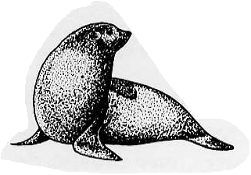
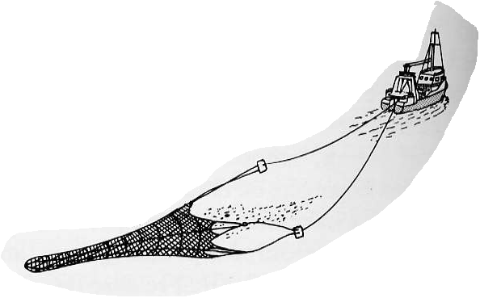
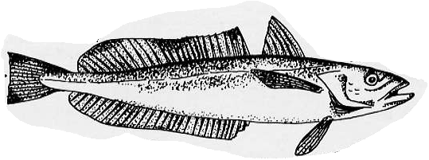
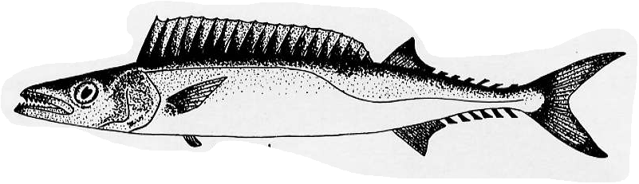



The South African Seal-Hake “Minimal Realistic Model”
Punt, A. E., & Butterworth, D. S. (1995). South African Journal of Marine Science, 16(1), 255-285.
Model Structures and
Management Systems
Management
Cull scenarios
Age-; sex-
structured
Catches
Fixed F
Species-; age-
structured
Delay-difference
A.E. Punt

Slide 51
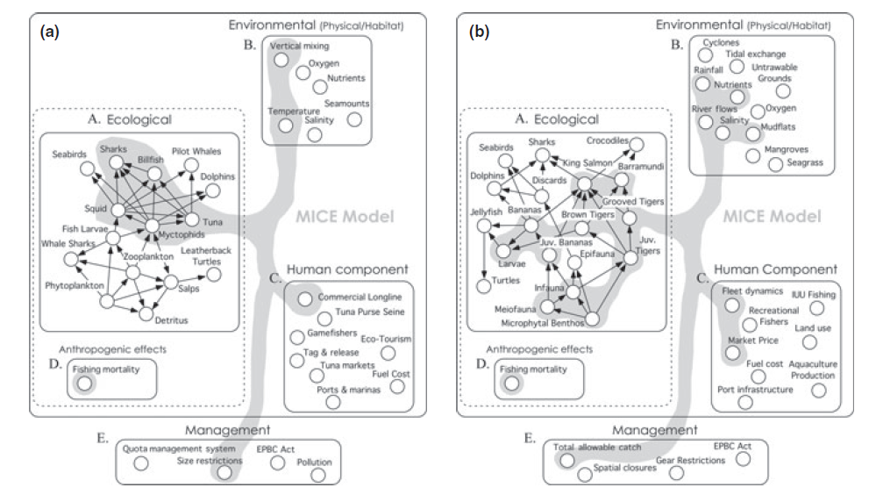
Models of Intermediate Complexity
Plagányi et al. (2014) Multispecies fisheries management and conservation: tactical applications using models of intermediate complexity. Fish and Fisheries. doi: 10.1111/j.1467-2979.2012.00488.x

Slide 52
Multispecies Models
Growing use of all types of models.
Some applications rarely used.
Continued development and enhancement of model construction.
Movement from heuristic to strategic/tactical applications.
These models are clearly more realistic!
BUT: Cost (data, institutional change) of application/implementation is high.

Slide 53
Conclusions
Used as “contextual” assessments
Disagreement between single-species and multispecies models CAN be informative.
Continued need for application
Predation add-ons for Forage species
Environment add-ons for Climate Change
There is no one “right” model to use, multi-model inference is preferable.
These models need to have adequate data quality for use.

Slide 54
“All models are wrong, some models are useful”
(George Box)

Slide 55
What do we need?
INFORMATION:
More diet, consumption rates, food habits, etc.
More links between env. and vital rates, prod.
RESEARCH:
Pros and cons of applications
More case studies of applications
Sensitivities
PROCESS:
Needs to be more directly inserted into SARC/STAR/etc.

Slide 56
Doing EBFM
Questions?

Slide 57
What’s Next?
Spring Break!
Aggregate & Ecosystem Models
Discussion on:
Collie et al. 2014
Plagányi et al. 2014
Steele et al. 2013

